Slide 1
What is machine learning ?
Machine learning is an application of artificial intelligence where a machine
Can learns from the past experience(i.e what ever the given input data in past)
and makes future predictions.
Types of machine learning:
Machine learning algorithms are three types they are:
Supervised learning
Unsupervised learning
reinforcement learning

Slide 2
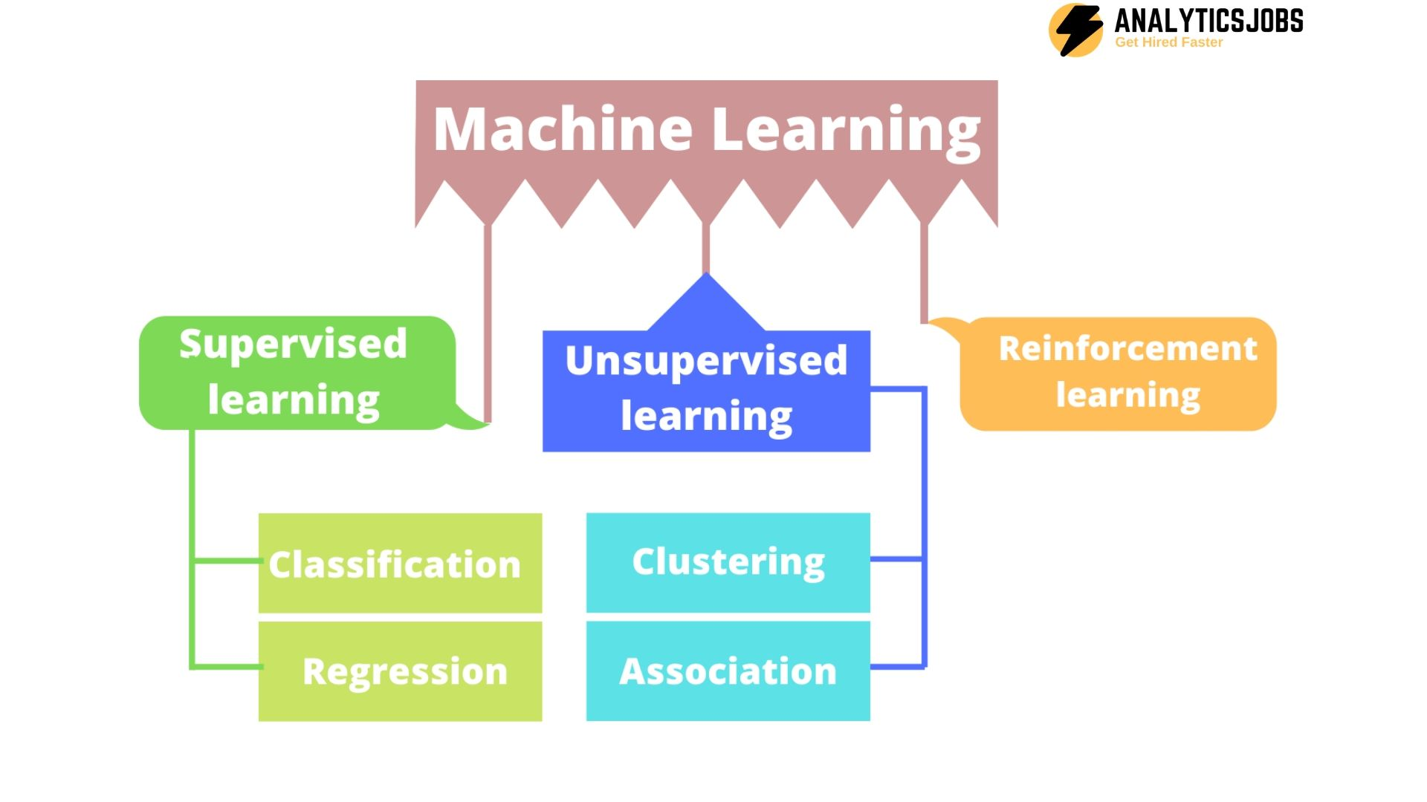

Slide 3
Difference between Supervised learning and unsupervised learning:
Supervised learning: -> supervised learning is a machine learning techniq In supervised
learning ,input data is provided to the model along with the output.
->Supervised learning algorithms are trained using
labeled data(output).
Example: predicting a house prize
Unsupervised learning: In unsupervised learning , only input data is provided
to the model.
In this output is unknown and there is no labeled data
and model finds the hidden patterns in data
Example: Email is spam or not .

Slide 4
Types of Supervised learning:
Supervised learning can be further divided into two types they are:
1.Classification
2. Regression
Classification: it is type of supervised where the data is in discrete format,and
the output variable is categorical, which means there are two classes such as Yes-No,
Male-Female, True-false, etc. and it is used to produce discrete results.
Types of classification:
support vector machine
naïve bayes
k nearest neighbor (knn)
Random forests
decision trees
Logistic regression.

Slide 5
2. Regression:
It is type of supervised learning where the data is in decimal format
and it predict numerical value. And it has continuous data.
Types of regression:
Linear regression
Polynomial regression
Ridge regression

Slide 6
Types of unsupervised learning:
Clustering: it is an unsupervised learning ,basically clustering
means grouping.
organizing or arranging any unlabeled data into similar
groups so it can modify well
Example:
fraud detection, spam filters.etc
Reinforcement learning:
It is type of machine learning , it is taking suitable actions
to maximize reward in particular situation.

Slide 7
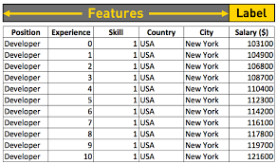
FEATURE AND LABEL
Feature : feature is also know as independent variable.
and it is input to your model.
Label : label is also know as dependent variable,
and it is output to your model.
Example:

Slide 8
Training and testing dataset :
Training dataset: training data is a subset of dataset ,here training data
is used to train our model .
Testing dataset: testing data is a subset of dataset ,here testing data
is used to test our model to get the accuracy of the
prediction .

